Slide 1
Simulation and Modeling
CSE4131_CSE4132

Slide 2

Recommended Book
System Simulation With Digital Computer
By Narshing Deo
Chapter 5: Simulation of a PERT network

Slide 3
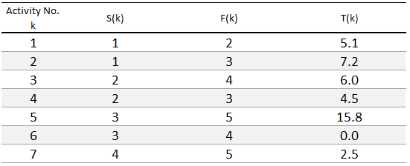
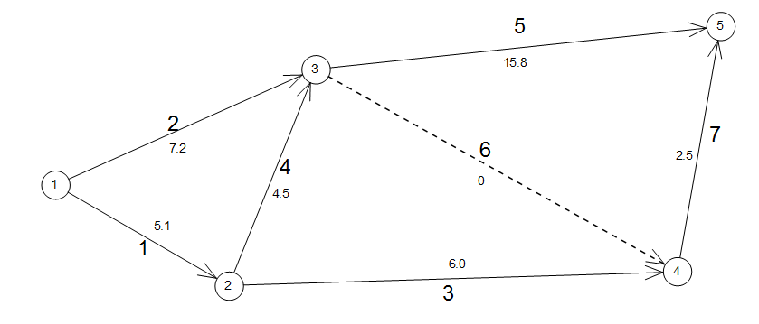
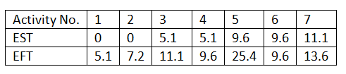

Finding Critical Path
Critical Path → the longest path in a network…
Critical Activities → activities along with the critical path…

Slide 4
We know…
EST (k) → earliest starting time for k^{th} activity
EFT (k) → earliest finish time for k^{th} activity
EFT(k) = EST(k) + T(k)
ENT(i) → earliest time when node i is achieved
Now,
Lets consider an activity called → J
Originating at node → S(J)
Terminating at node → F(J)
We already know EST(J) and EFT(J)

Slide 5
Critical Path…
How late can the completion of J be made without delaying the completion the project.
Let, LFT(J) → latest time by which J must be finished … without delaying overall project completion time.
And LST(J) → latest starting time.
So
LST(J) = LFT(J) - T(J) … … … … (Eq. 5.4)
Let, LNT(i) → the latest time by which a node can be achieved.

Slide 6
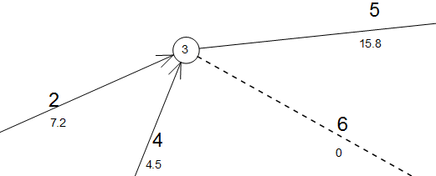
Critical Path…
LNT(i) = Min {LST (all activities originating at i)} … … … … (Eq. 5.5)
Reminder:
ENT(i) = Max { EFT (all activities terminating in i) } … … … … 5.2
LFT( every activities terminating in i) = LNT(i) … … … … (Eq. 5.6)

Slide 7
Backward pass
Now we start with sink vertex/ node M (= 5)
LNT(M) = TMIN = ENT(M) =25.4 days
LST(J) = LFT(J) - T(J) … … … … (Eq. 5.4)
LNT(i) = Min {LST (all activities originating at i)} … … … … (Eq. 5.5)
LFT( every activities terminating in i) = LNT(i) … … … … (Eq. 5.6)

Slide 8
Ex- Backward pass
LNT(5) = 25.4 days
LFT(7)=LFT(5)=25.4 days
LST(7)=25.4-2.5= 22.9 days (=LNT(4))
LST(5)=25.4-15.8=9.6 days
LNT(4)=22.9 days
LFT(6)=LFT(3)=22.9 days
LST(6)=22.9 -0 =22.9 days
LST(3)=22.9-6 =16.9 days
LNT(3)=MIN{ LST(5),LST(6)}={9.6,22.9}=9.6 days
LFT(4)=LFT(2)=9.6 days
LST(4)= 9.6-4.5=5.1 days
LST(2)=9.6-7.2= 2.4 days
LNT(2)=Min{ 5.1, 16.9} =5.1 days
LFT(1)=LNT(2)=5.1 days
LST(1)= 5.1-5.1=0 days
LNT(1)=Min {0, 2.4} = 0 Days

Slide 9
Slack
In forward pass ENT(i), EST(J) & EFT(J)
Backward pass LNT(i), LST(J) & LFT(J)
Slack= the difference between the latest time by which a node can be achieve (without delaying the project) and the earliest time of achieving that node.
LST(J) - EST(J) = LFT(J) - EFT(J)

